Slide 1


An Introduction
Proposal for Data Engineering Solution for Dropbox
February 2018
Actionable Insights. Accurate Decisions

Slide 2
Agenda
1
About LatentView
2
Background and Objectives
3
LatentView Solution Approach for Dropbox
4
Workplan, Engagement Model and Commercials
5
LatentView’s Data Engineering Capabilities
6
Select Case Studies in Data Engineering

Slide 3
1. About LatentView

Slide 4

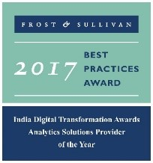





LatentView at a Glance
Founded in
Growing at an average of over
2006
Over
Work with
550
90+ %
30+
San Jose, Chicago, Princeton, London, Bangalore, Chennai, Singapore
People Strong
Fortune 500 Firms
YoY over last 5 years
Awards
Recognition
Member of
2009-2017
Customer council
Rated amongst the top
5%
4/5
10
Repeat business at
>85%
analytics companies to work for in India
Re-investment in Research and Development
top technology companies engage with us

Slide 5






























Who we work with

Slide 6













Why we are different
Business led Solutions
33% of our people have a business degree
Business + Data + Math + Technology
Focus on Innovation & Thought Leadership
IdeaLabs for innovation and research
Partnership with IIT Madras to create IIT Data Labs
Leaders in new age Data Platforms
AWS Advanced Consulting Partner, & Microsoft Azure Partner
Microsoft’s Gold Analytics Partner
Customized, Differentiated & Technologically scalable solutions
Amplifyr – Platform to understand drivers of customer behavior
Panel Miner – Cloud based data engineering platform to enhance digital user-experience

Slide 7
Key Capabilities
ENGINEERING
DATA PIPELINES
DATA LINEAGE
DATA
DATA HARMONIZATION
VISUALIZATIONS
STATISTICAL INFERENCE
MODEL
INTERPRETATION
MACHINE LEARNING
DATA
WRANGLING
STRUCTURED /
UNSTRUCTURED DATA
MATH
BUSINESS
ACTIONABLE
INSIGHTS
ARTIFICIAL
INTELLIGENCE
USE CASE
FORUMULATION
CLOUD
SEARCH
TEXT MINING
METRICS / KPI DEFINITION
PROCESS MINING
DATA LAKES
TECHNOLOGY
OPEN SOURCE APPLICATIONS
ANALYSIS
COMPUTE
RELATIONAL / NON-RELATIONAL DATABASES

Slide 8
LatentView @ Dropbox
LatentView has executed critical initiatives across multiple products and groups at Dropbox
Revenue Analytics
Marketing Analytics
Data Engineering
Engagement started April 2017
Upsells
User behavior analysis & Hypothesis Validation
Exploration & deep dive analysis to understand Upsells on a weekly basis
Plus
Worked with Plus Mobile Analytics to design, monitor A/B tests
Ideation to improve Plus Mobile Revenue & forecast incremental Revenue
OQ & NQ
OQ Email Infra Opportunity Models
Actions that leads to conversion of free users to paid users
Engagement started July 2017
Paper Analytics
User Segmentation & Campaign Lift Analysis
In-depth analysis to understand trends & drivers of Paper performance
Brand Campaign:
Monitor success metrics on daily basis & pattern analysis
Measure new sessions to the homepage & assessment of traffic quality based on session time in website
Campaign Attribution
Providing traffic attribution for marketing campaigns
Built dashboard to show conversion discrepancy across different data-sources
Engagement started Nov 2017
Data Marts
Creating multiple Business specific Datamarts for Revenue Analytics team
Data Pipelines
Building pipelines to lift & shift data from Hive to Redshift
Scheduling & Maintaining Data Pipelines using Airflow
Master Directory
Designing Master Directory by consolidating Fact & Dimension tables
Skills & Technologies Leveraged : SQL, R, Python, JavaScript, Tableau, Redshift, Google Analytics, A/B Testing

Slide 9
2. Background and Objectives

Slide 10






Dropbox – Current Data Ecosystem and Processes
Dropbox data ecosystem and toolset allows democratization of data across the enterprise
UI Tools
Data Sources
Data Pipelines
Hivepad
Aqueduct
Forge/Nexus
NightHawk
Log Explorer
Data Export
Oracle ERP
Ca$h
Dropbox Application
Dropbox Website
SFDC
Marketo
Zendesk
Bluemail
Sqoop
Kafka
Spreadsheets
Visualizations
Boomi
Sqoop
cLogger
Edgestore
Process & Tools
Data Storage
Hive
AWS Redshift
Campaign Lists/Stormcrow Population
Dropbox Data (App & Website) & Vendor data is sourced through different Data Pipelines | Data from multiple sources is routed through the respective data pipeline into data warehouse | Many UI tools are built on top of Hive to query, visualize, interpret data and schedule jobs | Data is exported out of Hive & Redshift to create Tableau dashboards & campaign lists
Democratized data: Dropbox allows all users to access & create data tables/views of their own (Exception to Restricted schemas)
Flexibility & Ease of Use: Dropbox offers flexibility with lot of UI tools which allows users/teams to explore & build custom reports
Short Time to Insights: Self-powered dashboards helps some product & analytics teams to make quick decisions on a daily basis
However this has led to some challenges…

Slide 11



Dropbox – Key Challenges
Existing data management process has led to challenges in terms of data governance and control
Uncertainty about Data Quality
Questionable Accuracy & Reliability: Uncertainty related to the data extraction and interpretation at the point of access, even for widely used team-specific tables with documentation
Missing Lineages: Difficulty in tracking metric definitions all the way back to the data sources
Limited Auditability: Inadequate process controls to ensure data quality and consistency
Lack of Ownership
No Accountability: e.g. individual owned datamarts might be static/deprecated without timely refresh
Complex Dependencies: e.g. various sections owned by various users making it difficult to trace & correct
Weak Access Control: e.g. anybody can edit/run other users’ Aqueduct jobs, making the jobs vulnerable
No Central Ground Truth
Decentralized/ Siloed Data Usage: Lack of consistency of metrics definitions across various teams; lack of harmonization of dimensions
Limited Reusability : Minimal documentation of metrics/tables restricts users to reuse existing tables; scope for improvement of metadata

Slide 12
Dropbox – Solution Objectives and Scope
Dropbox wishes to establish a robust data governance framework to enable a centralized, optimized, reliable and secure data environment for key business metrics
Q1
Establish a data governance framework and create a baseline for all key metrics
Q2
Publish 100% of all metrics (Tier 0 &1 ) via a centralized Data platform
Q3 & Q4
Certify 100% of all metrics(Tier 0 & 1) with governance standards
Data Governance (Process)
Business Intelligence (Insights)
Establish a data governance framework that provides overarching understanding of available data within Dropbox through lineage, DFD’s, metadata.
Data Engineering (Systems)
Build data pipelines that allow extraction of relevant data sets from sources into central store to enable key metrics reporting capabilities. (ETL)
Design and develop centralized data store/mart with capabilities to stage processed data and/or enable analytical reporting.
Develop standardized requirements gathering framework to identify key metrics
Build Data Quality Scoring models/cards enabling higher confidence and reliability on data sets.
Establish Metrics Accuracy Certification process - enabling overall auditability.
Develop a data Issue tracker to enable feedback capabilities.
Establish source and destination SLA
Build “What and When” dashboards for identified metrics/KPI’s across key BU’s.
Implement centralized portal that enables access to all dashboards built by BI team & other business units
Establish operational cadence for data and systems availability/monitoring.

Slide 13


Dropbox – Expectations from Vendor Partner
Dropbox has invited external partners who could bring in the required expertise and skills to develop a comprehensive solution and accelerate the initiative
Prior Experience in delivering similar Data Engg projects
LatentView strongly believes that it is uniquely positioned to deliver over and above the expectations of the current defined requirements.
Subsequent slides highlight our credentials and showcase a robust approach that will strengthen our case as Dropbox’s vendor of choice
Scalability of the solution
Expertise in Data Engg frameworks, tools & processes
Solution Based Approach
(not staff augmentation)
Familiarity with Dropbox business model & data environment
Track record of on-time delivery

Slide 14
3. LatentView Solution Approach for Dropbox

Slide 15



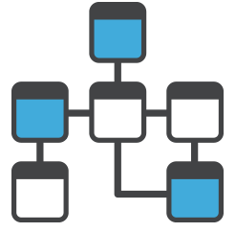






Current Architecture
A Hive data mart lies at the heart of the current architecture, which provides flexibility for analytics consumption, but lacks accountability and a centralized ground truth
Dashboards
External Data Sources
Managed Schema
Redshift Data Mart
ETL
Ad-hoc Development Schema
HIVE – Data Mart
Product Data Sources
Data Pipelines managed by Dropbox Data Infra Team
Data Pipelines created on ad-hoc basis by analysts
SLA bound data and metrics refresh
SLA bound data and metrics refresh
Access control for data & pipelines
Access control for data & pipelines
Ownership
Ownership
?
Change management process
Change management process
Documented lineage
Documented lineage
Key Requirement: Accountable Pipeline Process & Reliable Ground Truth

Slide 16






Proposed Solution Architecture
LatentView proposes the creation of a parallel data mart as a central ground truth powered by a reliable metrics foundry, SLA bound pipeline orchestration and a robust data governance framework
Dashboards
External Data Sources
Managed Schema
Redshift Data Mart
ETL
Ad-hoc Development Schema
HIVE – Data Mart
Product Data Sources
Source Data
1
ETL
3
Metrics Foundry
2
Data Mart
Pipeline Orchestration Framework
Business Users & Analysts
Configure
4
Data Governance – Enforce ACLs, Expose Definitions of metrics, lineage and pipelines
LatentView Solution

Slide 17




Proposed Technology Options
We believe a combination of open source tools and an AWS foundation will be optimal for the proposed solution
Dashboards
External Data Sources
Managed Schema
Redshift Data Mart
ETL
Ad-hoc Development Schema
HIVE – Data Mart
Product Data Sources
Source Data
1
ETL
3
Metrics Foundry
2
Data Mart
Pipeline Orchestration Framework
Redshift
Business Users & Analysts
Configure
4
Data Governance – Custom Module, AWS STS, AWS IAM Policies
LatentView Solution
View Details

Slide 18
Future Roadmap
The proposed data mart will scale seamlessly to enable advanced analytics, visualization and custom UI & services to business and power users alike
Dashboards
External Data Sources
Managed Schema
Redshift Data Mart
ETL
Ad-hoc Development Schema
HIVE – Data Mart
Product Data Sources
Source Data
Advanced Analytics
1
ETL
3
Metrics Foundry
2
Data Mart
Pipeline Orchestration Framework
Visualization
Redshift
Business Users & Analysts
Configure
Configure
4
Custom UI & Services
Data Governance – Custom Module, AWS STS, AWS IAM Policies
LatentView Solution
Future Roadmap

Slide 19
1. Metrics Foundry
An indexed and searchable repository of all metrics made available to all users of the platform
Features
Indexed List of all metrics
Metric definition standardization
Ownership and Lineage of Metrics
Frequency and Quality aspects of Metrics
Benefits
Authoritative Metrics Repository and minimal UI to track and view details
Centralized Configuration Store for pipelines, governance and visualization
Methodology
Develop a Lexical Parser to process Hive scripts and decipher:
Metrics Lineage
Source to output computation / transformations
Conduct user interviews to understand
Current frequency of refresh, expected SLA for refresh frequency
How to ascertain and assure quality of the metric
Business Owner and definition of the metric
ACLs (at a user group level)
Recommended Technology

Slide 20

2. ETL & Data Pipelines
SLA bound pipeline orchestration will be enforced to populate data into the data mart
Features
ETL jobs
Metrics Computation
Scheduling and Logging
Benefits
Transparent Computation Layer with visibility into process SLA, QA
Computation orchestrated by DAG-driven tools such as AirFlow
Methodology
For the list of metrics, consolidate the required number of output data tables
For each table, in respective grain, create ETLs from managed schema to destination data mart
ETLs to honor the computations as captured in the lineage and transformation rules
ETLs to enforce QA checks for duplication, value consistency and treatment of missing values
ETL s may start off as one to one mapping i.e. each table output will have a pipeline.
In later stages, pipelines can be consolidated to populate multiple tables using metrics foundry as config.
Pipelines to log the process SLA and QA summary
Recommended Technology

Slide 21
Types of Data Pipelines
We decide the buckets based on the complexity of processing and the possible optimizations
Simple
Moderate
Complex
Very Complex
Move without schema change
Optimize Redshift for Existing Schema
Intra-table schema changes
Semantic layer extended, no impact on current reports
Consolidate multiple tables to avoid aggregations & joins
Reporting Changes
Complex data transformations involving hierarchical / graph queries, complex lookups / windowing, multiple lags, etc.
1. Lift & Shift
2. Intra-table Changes
3. Inter-table, Same Platform
4. Inter-table, Multiple Platforms
What does it involve?
More efficient queries through better distribution and sorting, no impact on semantic layer
Improved efficiency of queries through creative pre-processing and extended semantic layer, no impact on semantic layer
Instream enrichment workflows to avoid complex joins resulting in simpler & more efficient queries. Semantic layer is simpler than before
Workflow management using DAG, sometime even involving specialized tools for specific purposes (e.g. Spark GraphX) for reduced complexity and more efficient processing
Migration Impact
More Details

Slide 22
3. Data Mart
A Custom Data Mart will be built to deliver the central ground truth
Features
Data model design
Pre-populated Aggregations at different grains
Audit Logs
QA Summary
Benefits
Central Ground truth for Metrics
Approved based on QA
Methodology
Based on metric definitions, design data model and reflect the same in ETL design
Understand visualization/ business consumption requirement to ensure data model support
Create aggregate data models for easier visualization by rolling up from most granular fields
Capture as-was data in a staging environment and store the as is data in a data mart
Optimize the loads, compress the data and enforce appropriate indexing for efficiency
Recommended Technology
Redshift

Slide 23
4. Data Governance
Enforce ACLs and SLAs, Expose Metrics definitions, Lineage, Ownership and Schedules
Features
Defined & Documented
Traceable & Accountable
Iteratively improvised Knowledge store
Auditable and Transparent
Benefits
Single Repository to capture all specifics related to metrics
Iteratively improvise the rules based on ground reality
Methodology
Understand the user & user group to role & access mapping for different datasets
Discover, explore and document the computations from source to arrive at a metric (Lineage)
Document the details of metric ownership and definitions over time
Enforce, track and audit the prescribed ACLs, SLAs and schedules as per requirements
Recommended Technology
Custom Module, AWS STS, AWS IAM Policies

Slide 24
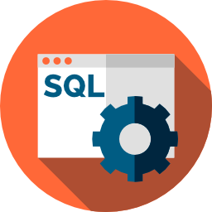


Project Execution Plan
Metrics Foundry Team
Data Pipeline and Data Mart Team
Data
Governance
Team
HIVE – Data Mart
ETLS
Output Data Mart
Ad-Hoc Development Schema
Implement
data processing and computations
Data Model to accommodate metrics and dimensions
Managed Schema
Log all activities, data and analyze quality of process
HIVE SQLs
Reverse Engineer
DAGs
QA &
Access Control
Semi-Automated Lexical Parser
Pipeline Orchestration and Dependency Management
Ensure secure authentication
Manual Analysis
Validate data and enforce
Schema, Table level Access control
Documentation
Metric definition and ownership
User level access control
Pipelines, SLAs and Schedules
Configuration Driven
Central Ground Truth
Enforce Access Control
EMR
Metrics Foundry
Config Driven Pipelines
Reliable data mart
Secure Access

Slide 25
4. Workplan, Engagement Model and Commercials

Slide 26
Project Timelines
We expect to complete the deliverables in 3.5 months* using a rapid, parallelized development approach
Interim Milestone for review & feedback
Activity | Estimated Timeline
 | Sprint 1 |  | Sprint 2 |  | Sprint 3 |  | Sprint 4 |  | Sprint 5 |  | Sprint 6 |  | Sprint 7 |  | Sprint 8 |  | Sprint 9 |  | Sprint 10
 | Week 1 | Week 2 | Week 3 | Week 4 | Week 5 | Week 6 | Week 7 | Week 8 | Week 9 | Week 10 | Week 11 | Week 12 | Week 13 | Week 14 | Week 15 | Week 16 | Week 17 | Week 18 | Week 19 | Week 20
Introductions and Set up
Current Architecture
Metrics prioritization
Lexical Parser
Understanding metrics definitions & frequency | Metrics 1 – 10 |  | Metrics 11 – 20 |  | Metrics 21 – 30 |  | Metrics 31 – 40
Understanding lineage for each metric
Design output tables |  |  | Metrics 1 - 10 |  | Metrics 11 - 20 |  | Metrics 21 - 30 |  | Metrics 31 - 40
Hive to output tables pipelines
Orchestration & Dependencies
Data Model design; alignment with ETL design |  |  |  |  | Metrics 1 - 10 |  | Metrics 11 - 20 |  | Metrics 21 - 30 |  | Metrics 31 - 40
Staging area development
Aggregate data models to enable analytics reporting & for business consumption
Data quality scoring: Log all activities, data & analyze quality
Enforce, track & audit the prescribed ACLs, SLAs & schedules |  |  |  |  | Metrics 1 – 10 |  | Metrics 11 – 20 |  | Metrics 21 – 30 |  | Metrics 31 – 40
Document metrics ownership & definitions
Establish metrics accuracy certification & feedback process |  |  |  |  |  |  | Metrics 1 - 10 |  | Metrics 11 - 20 |  | Metrics 21 - 30 |  | Metrics 31 - 40
Establish operational cadence for availability/monitoring
Discovery
Metrics Foundry
Data Pipelines
(using existing Hive tables)
Data Mart
Governance
UAT
* About 4 weeks additional effort for building data pipelines directly from source tables

Slide 27
Potential Risk Factors
Following risks are likely to cause time and budget overruns. We will implement a robust risk avoidance and mitigation plan.
Risk Factors | Probability | Severity | Pro-active Avoidance & Mitigation Plan
Unforeseen complexity of some metrics; dynamic changes in metric granularity | High | Medium | LV will leverage manual & automated methods to expedite the process; Additional buffer already added to the schedule to allow for such slippages
Lack/ delay in consensus on metric definition | High | Medium | Additional buffer has been added to the schedule to allow for such slippage
Delay in access to documentation on previous analyses of key metrics, data sources, & reports that may require SME outreach; unavailability of SMEs | Medium | High | LV will call out gaps immediately & work with Dropbox POC to selectively connect with relevant SMEs for quick turnaround
Mid-project change of scope e.g. inclusion of more metrics or additional deliverables | Medium | High | LV will provide recommendations; will get expedient sign off from Dropbox POC
Delay in required access privileges to tools, platforms, databases/ tables/ schemas in Dropbox environment | Medium | High | LV will work with Dropbox IT to expedite the process
Delay in receiving work authorization for onsite resources | Medium | Medium | LV will prioritize staffing resources already possessing US work permits; if required premium visa processing of Visas will be done for additional resources
Resource & skill set mismatch and performance concerns | Low | High | LV will deploy resources from Data Engineering center of excellence with deep expertise in AWS architecture & business Analysis
Lack of timely review, feedback and approval by Dropbox Point of Contact (POC) | Low | Medium | Additional buffer has been added to the schedule to allow for such slippage
Delays in initial offshore set-up activities due to Security Authorization; legal & statutory compliance | Low | Medium | LV has enterprise wide ISO 27001 compliance; LV to identify requirements and bottlenecks upfront and work with Dropbox IT to ensure 100% security compliance

Slide 28
Data Engineering Skill Matrix
Skill Group | Data Engineering Skills | Skill Level | Resource Strength
AWS Cloud | S3, Redshift – Database | Expert & Early Adopters (RedShift) | High
 | EC2, EMR, Spark, Hive, Presto - Compute | Expert | High
 | Athena, Glue, Spectrum - Interactive Analytics | Expert and Early adopters | Low
 | SQS, SES, SNS - Messaging | Expert | Medium
 | DynamoDB, ElastiCache/Redis - NoSQL | Expert | Medium
Data Architecture | Data modeling for distributed row / column oriented and column family data stores, partitioning, serialization, data structures | Expert | Low
Data Modelling Tools | Erwin / other tools | Beginner | Low
Orchestration Tools | Airflow | Intermediate | High
 | Glue, Pentaho, Informatica | Beginner | Low
User Interface Dev. | Angular, HTML, CSS | Intermediate | Low
Data Governance | IAM | Intermediate | Medium
Visualization | Tableau | Expert | High
Development | Python, Shell Scripts, SQL | Expert | High
 | Scala | Expert | Low
Administration | DB Administration | Beginner | Low
 | Infrastructure | Beginner | Low

Slide 29
LatentView’s AWS Capabilities
01
02
03
AWS Advanced Consulting
Partners since 2012
Certified Onsite & Offshore resources
Enabling Analytics on Cloud for 5+ years
Collaborate with AWS Architects
Worked with leading AWS Architects for design and implementation across multiple accounts
Early Adopters
AWS Data and Analytics Platforms like Redshift, Glue, Athena, EMR
04
05
Improved product roadmap with feedback on Glue, Redshift, AWS Data Lake
Developed & presented embarrassingly parallel computation framework
AWS re:Invent 2014

Slide 30



Proposed Team Structure Options & Pricing
Though we have the capability of delivering the solution with a completely onsite team, we would recommend a flexible onsite-offshore model that is highly cost-effective, scalable and efficient
Recommended
OPTION 1
(Onsite Only)
OPTION 2
(Onsite-Offshore Model)
Onsite (US)
Onsite (US)
Offshore (India)
Lead Consultant
Team with varied expertise – BA, DE, Data Architect
Lead Consultant
Data Engineer
Offshore Lead
Team with varied expertise – BA, DE, Architect
Additional members will be added as required
Scalable pool of offshore Analysts will be added as required
Proposed Fee: $110k / month
Proposed Fee:
$65k / month

Slide 31
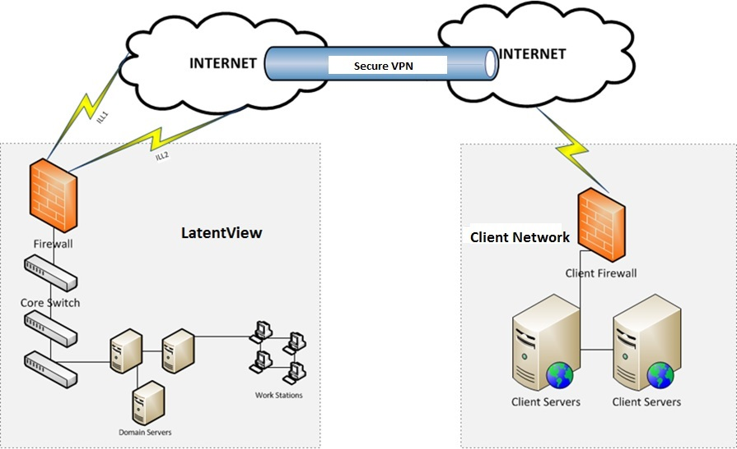
Onsite – Offshore Model: Details
Fundamental Policies
Data remains within Dropbox network
All data, computing & modelling to be done in Dropbox infrastructure
Onsite team members will work from Dropbox office in San Francisco
Client provided & security cleared machines to be used in offshore
Offshore team members will have access only through VPN Via secured gateways
No Downloads and Uploads to and from Virtual Network
No code or data is shared over email or any other communication mechanism
Code to be maintained and documented in git
Distribution of work between onsite and offshore
Offshore
Onsite
ETL Instrumentation
Coding & Development of modules
Access and test data via secure VPN
ETL Dependency Management
Test dependencies
Instrument and benchmark on test data
Data & Process QA
Present data & metrics summary
Data & Code shared via approved tools
Process Discovery
Reverse engineering Metrics
Automation
Review of Metrics QA
Project Communication
Enforce Data Governance
Access Control Rules
Security Requirements
More Details

Slide 32
5. LatentView’s Data Engineering Capabilities

Slide 33
LatentView’s Data Engineering Capabilities
Trends and Challenges in a typical Modern data-driven Enterprise
Trends in Analytics
Challenges
Rapid proliferation and broad adoption of Analytics within the organization
Insights are based on wide range of data sources, with varying levels of Trustworthiness
Competitive pressures force business people to take things into their hands
Hampered by lack of flexibility in IT-centric tools, businesses are creating redundant and inconsistent views of data
Pressure to do things faster leads to hacks rather than long term solutions
Pervasive anti-patterns impacting scalability, reliability, maintainability
Diversity in Analytics use cases as well as tools landscape
Current infrastructure does not enable everyone to be productive
Increasing complexity of moving from data to insights to ROI
Lack of Analytics talent that can help organizations exploit opportunities in data
33

Slide 34
LatentView’s Data Engineering Capabilities
LatentView brings together the right blend of capabilities to helps clients get to their insights faster while improving trust
Capabilities
Use Cases
Architect & Design
Data Integration & Harmonization
End User Discovery & Access
Metadata & Cataloging
Security, Privacy, Authentication & Access Control
Data Roadmap Consulting
Data Lakes, Data Warehouse
Domain-specific Applications
Machine Learning Workbenches & Scoring Engines
Data Services
Agile Data Labs and other end user Analytics
34

Slide 35
LatentView’s Approach Data Engineering
Our business-focused approach helps provide different levels of end user capabilities from any source of data by leveraging modern architectures
Business focused
Support Diverse Audiences
Insights from ALL data
Modernize Architecture
Deep expertise in Architecture
Business-focused Approach to Data Engineering to align analytics and technology
Workload-centric Architectures to meet different needs of business stakeholders
Fusing of conventional with Unconventional data for deeper and more meaningful connections
Focus on building scalable, reliable and maintainable analytics solutions & data products
Transition to modern data environment while preserving value from technology investments
35

Slide 36
1. Bridge the gap between Business and Technology
LatentView brings critical capabilities that helps bridge the Business-Technology gap
01
Understand People – who, how they make decisions, biases, where they fall short
05
02
Drive accountable adoption of Analytics within the organization for better decision making
Analyze Information Usage in Decision Making – Discovery, Brainstorming, Higher order questions
04
03
Data-driven Learning – data labs, experimentation & hypothesis testing, cause-effect modeling
Blend critical technical skills: Business + Data + Math + Technology
36

Slide 37
2. Build for Diverse Analytics Needs with Workload-centric Architectures
LatentView’s Workload-centric architectures help democratize insights beyond data warehousing
CANNED REPORTS
Data Integration
Relational Data Store
(Ex: AWS Redshift)
Enterprise Reporting Platform
Conventional Data Sources
Structured
Data Lake
(Example: S3)
SELF SERVICE BI
Unconventional Data Sources
Indexing and Querying
(Ex: Elastic Search)
API endpoints
OPERATIONAL
External Data Sources
Unstructured
Machine Learning Workbench
ADVANCED ANALYTICS
Distributed Processing
Feature Engineering
Data Sampling
(Ex: Spark)
Internal Data Sources
Real time Indexing
(Ex: Elastic Cache)
REAL TIME REPORTING
Data Type specific ETL toolset
Isolating Compute from Storage for Throttle Free, Optimized, Cataloged, Secured and Accountable Single View
Workload Aware Compute
37

Slide 38
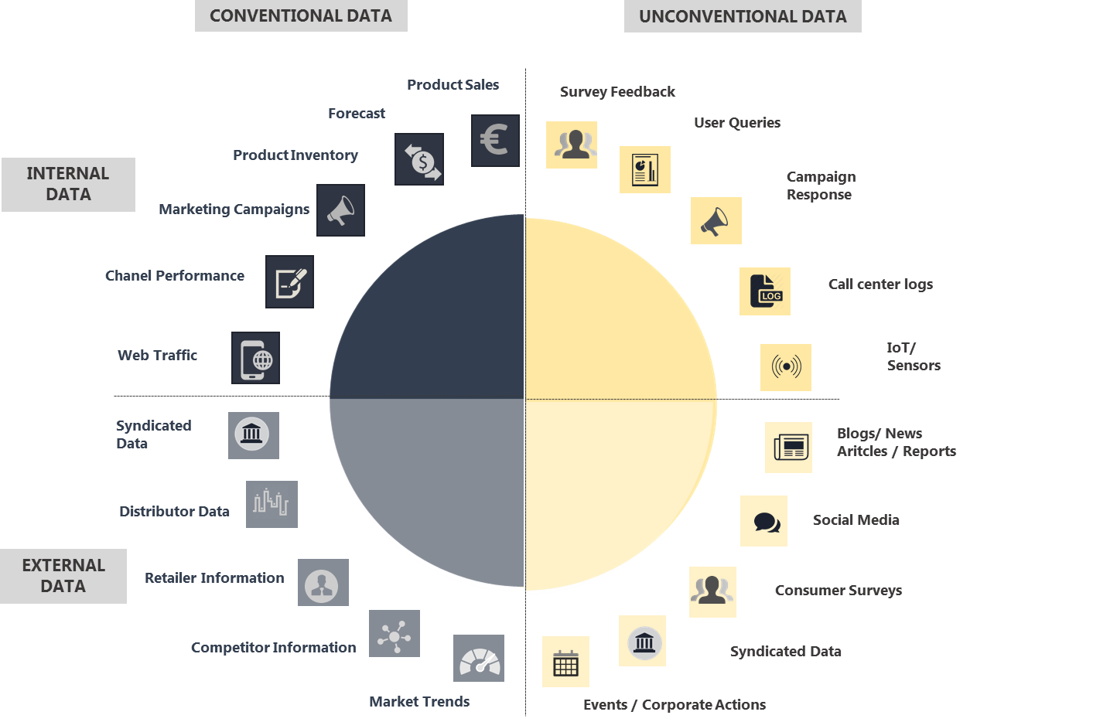
3. Fuse All Data for Deeper and Meaningful Connections
Fusing conventional and unconventional data leads to unbiased and more granular insights, at lower cost in lesser time
38

Slide 39
4. Design Data Architecture for Scalable Systems
LatentView has deep experience in building scalable, reliable and maintainable analytics solutions and data products
Relational / OLAP
Column family
Document
Graph
Key-value stores
Thrift, Avro, ProtoBuf, language-specific
Different modes of data flow: DBs, RPC, REST, Message passing
Key-Value partitioning
Secondary indexes
Balancing & rebalancing
Event streams
Database streams
Processing streams
Data Modeling
Storage & Retrieval
Serialization & Evolution
Replication
Partitioning
Batch Processing
Stream Processing
Indexing structures
Star schema with snowflakes
Column oriented storage
Single-leader
Leaderless
Multi-leader
Scripting
Map-Reduce
Traditional ETL
Directed Acyclic Graphs
39

Slide 40
5. Bridging New Age & Legacy Technologies
LatentView has experience in helping transform traditional BI environments to modern architectures
Re-Hosting
(Lift & Shift)
E.g. MicroStrategy to MicroStrategy cloud service
Benefits from reduced capex / opex
Migration tools can automate
Simpler to manage adoption
Works well for simple, stand-alone systems
Not much benefit from technology optimization
Integration with on premise apps
Re-Platforming
(Tinker & Tune)
E.g. Netezza Data Warehouse to AWS RedShift
Better optimization of parts of the stack
Save license / capex / opex / labor cost
Simpler to manage adoption
Some old features may not work as well (e.g. RedShift push down vs Netezza)
New usage patterns may be needed
Repurchasing
E.g. Moving from Open source Spark to hosted Databricks Spark
Benefit from major optimizations in new tools
Goes beyond cost savings to innovation / agility
Challenging integration of data with new apps
Significant investments in training analysts / data scientists
Refactoring
E.g. Move from EDW to a Big Data architecture
Reimagined app with cloud-native features
Adds features, scale or performance lacking before
Most complex & most expensive
Challenge of training users and maintainers
Old use cases may require additional work
40

Slide 41
6. Select Case Studies in Data Engineering

Slide 42

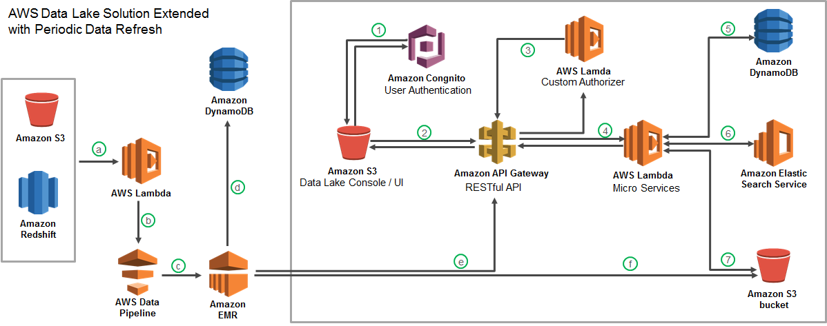



Case Study 1: Centralized ground truth enabled enterprise data lake
Largest Food Distributor in the US
The Problem: Ageing legacy Business Analytics Infrastructure with high cost of ownership slowing down realizable analytics value
The “Before” State
LatentView Solution
The “After” State
Business users faced significant delays in accessing and analyzing data and had difficulty in handling large volumes of data.
Migrated 60TB of data from legacy systems into the AWS data ecosystem with extended periodic data refresh and enforced access control mechanism
Created a large scale cloud data platform leveraging AWS ”Cloud Formation” template using scalable tools such as EMR, Spark, Glue, Zeppelin and R Studio
Recommendation Engine
Order Anomaly Detection
Product Substitution
Revenue Management Use Cases
View Details

Slide 43
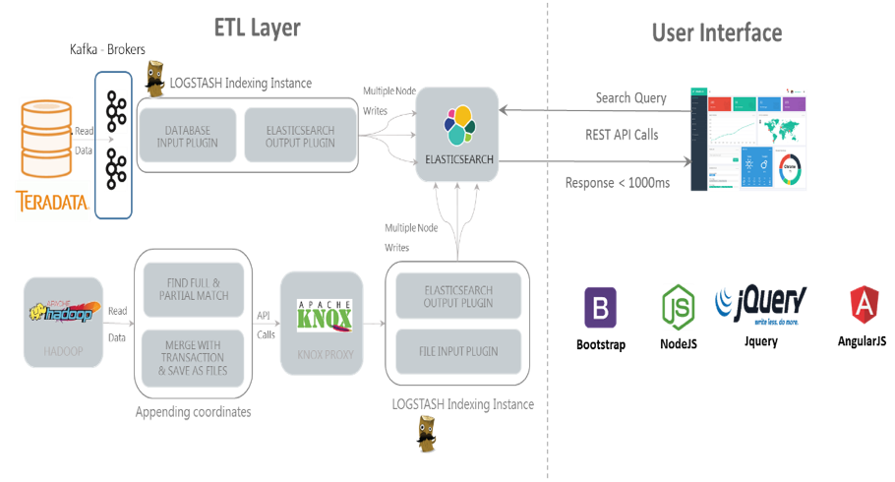
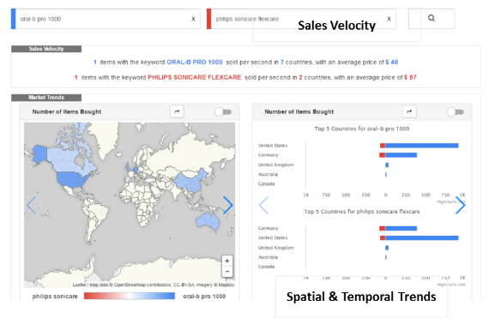
Case Study 2: Define & visualize metrics for real-time purchase trends
Multinational E-Commerce Corporation
The Problem: Lack of clarity on metric identification and platform to visualize purchase trends
The “Before” State
LatentView Solution
The “After” State
Client did not have a common platform which buyers/sellers could use to understand what the popular products were and how they were trending across geographies
Identified KPIs & built a real-time platform to understand purchase trends using MEAN stack and elastic search to handle larg volume of historic transaction data from different source systems (Teradata, Hadoop)
A real-time platform to visualize metrics/KPIs to understand purchase trends from 4TB of historic transaction data over 3 years with a response time lesser than 1000 ms
Technical Architecture
Platform Snapshot
43
View Details

Slide 44
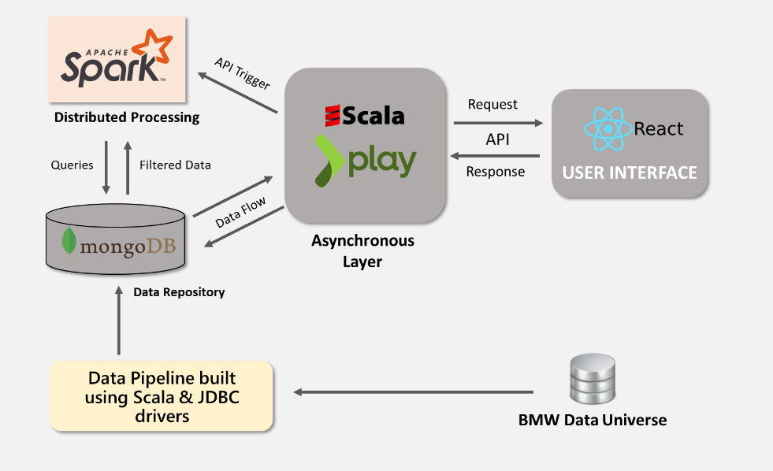

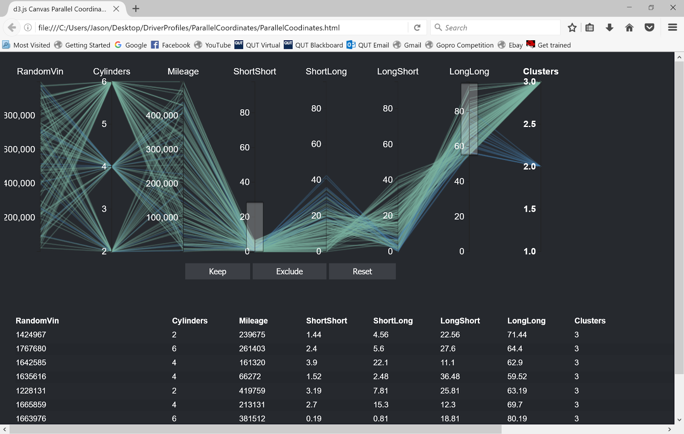
Case Study 3: Robust, scalable data platform for analytics
European Automobile Manufacturer with several iconic brands in their portfolio
The Problem: Huge volumes of data with no robust scalable data platform for analytics
The “Before” State
LatentView Solution
The “After” State
A robust data platform was built using AWS for scalability enabling parallel computing using Spark. The data platform facilitated machine learning using Scala and visualizations using D3.
The data platform processed over 5 GB of data and provided interactive visualizations with response time less than 2s. This platform hosted analytics tools which processes petabytes of data
Data flowing in from the car’s controllers are not standard across vehicle and software releases. Data analysis and insights generation was time consuming.
Technical Architecture
Platform Snapshot
Controller Readout Data
Hypothesis Testing Tool
View Details
44

Slide 45


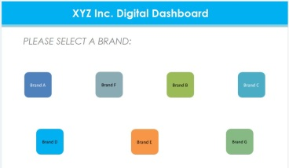




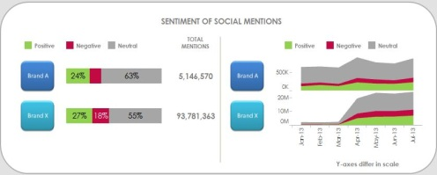
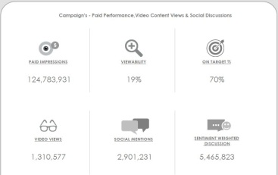
Case Study 4: Integrated platform for tracking digital metrics
Leading Global Food & Beverages Corporation
The Problem: In the CPG industry, lack of a unified view of marketing data can result in incorrect analysis and wrong conclusions, thus leading to “throwing good money after bad” situation with respect to marketing spends
The “Before” State
LatentView’s Solution
The “After” State
Siloed platforms provided a disjointed view of marketing effectiveness resulting in a protracted test cycle for campaigns
Built an integrated dashboard with paid, earned and owned media metrics that facilitates cross-channel, cross-brand and cross-campaign comparison to gain deeper marketing insights
Test cycle for campaigns reduced by 25%, thus resulting in a decrease in cost per campaign by as much as 8%
Automated Integrated System
Enterprise Data Architecture
Cloud-based reporting system
Extraction
Warehouse
Presentation
Key metrics:
Historical data
Flat Files
ETL
Content marketing - Likes, Posts, retweets, re-pins, comments etc.
Web traffic & audience engagement - Site visits, Sessions, Session duration, Page visit depth etc.
Video ad – Views, Viewer growth, Subscribers, likes, dislikes etc.
Paid campaign – Impressions, Viewability rate etc.
Social buzz – Mentions, brand sentiments etc.
API
Extraction
Transformation
Loading
API
API
Meta data
To dashboards
API
Raw data
Summary data
Data Sources
Staging tables
Data mart
View Details

Slide 46
Appendix

Slide 47
Comparison of Technology Options for the Proposed Solution
Metrics Foundry Options | JSON Based Storage | Field Level Editing | Search API
File based | Yes | No | No
Redis | Yes | Yes | No
DynamoDB | Yes | Yes | No
Elastic Search - Preferred | Yes | Yes | Yes
ETL Options | Programmatic | Scheduling & Orchestration | UI
Azkaban | Yes | Yes | Yes
Luigi | Yes | Yes | No
Airflow - Preferred | Yes | Yes | Yes
Data Mart Options | Scale up/down on Demand | Access Control
Hive | No | Yes
Redshift - Preferred | Yes | Yes
Back

Slide 48
Expectations from Dropbox
Access to documentation and SMEs for familiarization to the Dropbox’s technology stack, business and data environment, existing reports, systems, tools, products and processes
Timely access to the technology infrastructure and required privileges in Dropbox environment for LatentView to develop and deploy the solution
Requisite licenses for any third-party tools required – may be provided by Dropbox or LatentView can procure the same (with Dropbox approval) and be reimbursed on actuals
A designated Point of Contact (POC) for the engagement will be provided by Dropbox:
To help in coordinating Knowledge Transfer sessions, access to business teams for business understanding and data queries
Review of deliverables, project status tracking and resolving queries / issues

Slide 49
Details on Data Pipeline Complexity Levels

Slide 50
Group 1: Lift & Shift
Move without schema change
Task | Description | Assumption
Data Model | Existing tables (facts & dimensions) will move as-is. No changes to column and associated data types | No Schema Change and destination schema would reflect current data mart
One Time Data Load | 2 Options: Custom Pipelines for one time load AWS Snowball for massive data loads | Load will happen for a fixed timeline in reverse chronological order (for option #1)
Data Integration for Continuous load | Source mappings that load data into current data mart tables can be reused and can be edited to also send an update to S3 | Client will allow access to the source data from the source systems or interim data mart
Semantic Layer | No Change to semantic layer | KPI & Reporting remain the same
KPI Reporting | Validation of sampled key critical reports | KPI & Reporting remain the same
Back to Summary

Slide 51
Group 2: Intra-Table Changes (Moderate)
Intra Table Schema Change, Light Weight Post Processing to facilitate querying
Task | Description | Assumption
Data Model | Existing tables (facts & dimensions) will move with minor preprocessing to facilitate querying | Existing columns would continue to exist and additional columns will be added to avoid any regression
One Time Data Load | New scripts and pipeline to be written to load data from corresponding tables in S3 to tables in Redshift | Load will happen for a fixed timeline in reverse chronological order
Data Integration for Continuous load | Source mappings that load data into destination tables will be modified to perform preprocessing In some scenarios, the output from current data mart would be persisted in AWS and processing would be done later | Client will allow access to the source data from the source systems or interim data mart
Semantic Layer | No Change to existing semantic layer. New semantics to be added with the new enriched columns | KPI & Reporting remain the same
KPI Reporting | Validation of sampled key critical reports by using the new semantics & swap reporting changes once validated | KPI & Reporting remain the same
Back to Summary

Slide 52
Group 3: Inter-Table Changes – Same Platforms
Aggregation, Joins For Denormalization, Change Of Schema, Reporting Changes
Task | Description | Assumption
Data Model | Existing tables (facts & dimensions) will move with major preprocessing to facilitate querying and effective reporting | Existing columns would continue to exist and additional columns will be added to avoid any regression
One Time Data Load | New scripts and pipeline to be written to load data from corresponding tables in S3 to tables in Redshift | Load will happen for a fixed timeline in reverse chronological order
Data Integration for Continuous load | Source mappings that load data into destination tables will be rewritten to perform complex sequence of dependent operations. Output of this process will be flat and highly denormalized | Client will allow access to the source data from the source systems or interim data mart
Semantic Layer | No Change to existing semantic layer. New semantics to be added with the new enriched columns | KPI & Reporting remain the same
KPI Reporting | Validation of sampled key critical reports by using the new semantics & swap reporting changes once validated Old reports will be generated out of current data platform for business continuity until the validation exercise is complete | KPI & Reporting remain the same
Back to Summary

Slide 53
Group 4: Inter-Table Changes – Multi Platforms
(Very Complex)
Referential Integrity, Anomaly Detection in Addition to Complex Changes, External Sources
Task | Description | Assumption
Data Model | Existing tables (facts & dimensions) will move with major preprocessing to facilitate querying and effective reporting | Existing columns would continue to exist and additional columns will be added to avoid any regression
One Time Data Load | New scripts and pipeline to be written to load data from corresponding tables in S3 to tables in Redshift | Load will happen for a fixed timeline in reverse chronological order
Data Integration for Continuous load | Source mappings that load data into destination tables will be rewritten to perform complex sequence of dependent operations with lot of validations on referential integrity and anomalies | Client will allow access to the source data from the source systems or interim data mart
Semantic Layer | No Change to existing semantic layer. New semantics to be added with the new enriched columns. | KPI & Reporting remain the same
KPI Reporting | Validation of sampled key critical reports by using the new semantics & swap reporting changes once validated Old reports will be generated out of current data platform for business continuity until the validation exercise is complete | KPI & Reporting remain the same
Back to Summary

Slide 54
Data Security Policies and Procedures

Slide 55
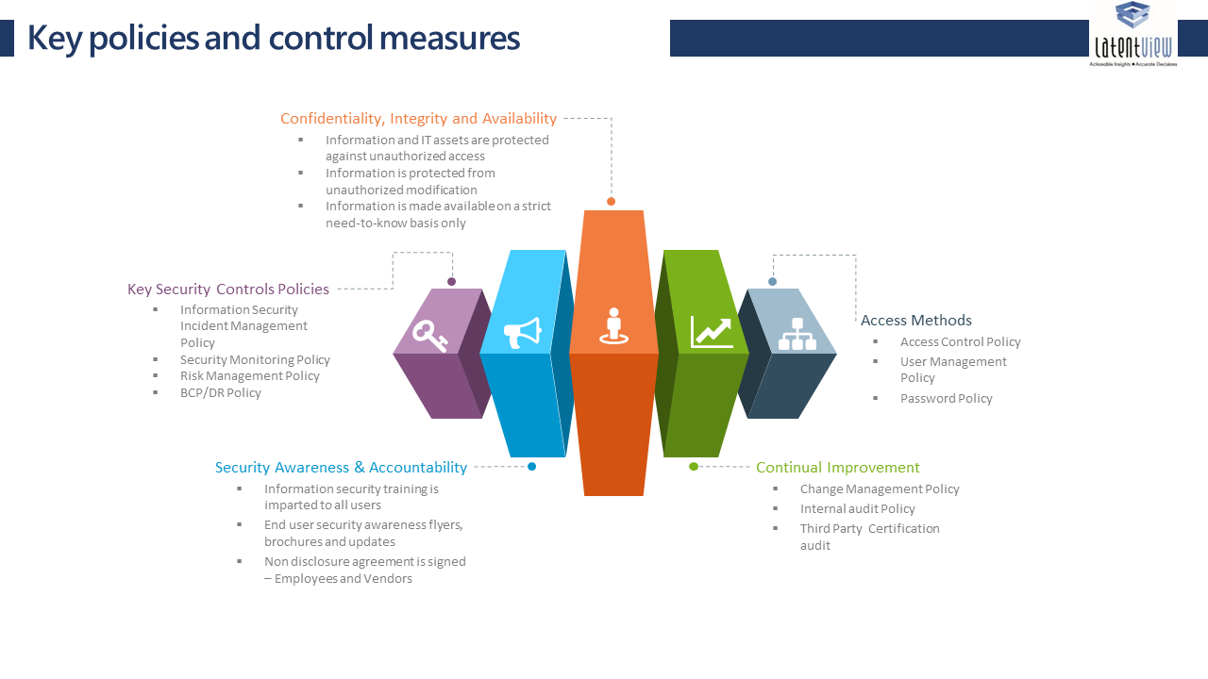
Key Elements of Data Security Policy
LatentView has a stringent data security policy to ensure confidentiality, integrity and availability of client data and information assets
© LatentView Analytics. Confidential

Slide 56
Data Security Controls and Guidelines
LatentView shall implement appropriate security controls to ensure that all employees are actively engaged and committed to maintaining standards of information security
Information assets are identified and categorised in terms of business value.
Ownership of information assets is established and responsibilities defined.
Information and IT assets are protected against unauthorized access.
Information is made available on a strict need-to-know basis only.
Information is not disclosed to unauthorized persons through deliberate or careless action.
Confidentiality of information is assured in accordance with client agreements and best practices.
Information is protected from unauthorized modification.
Applicable regulatory and legislative requirements are met.
Disaster recovery plans for IT assets are developed, maintained and tested.
Information security training is imparted to all users of information assets.
Information security breaches are reported, investigated, resolved, and closed.
A culture of compliance towards information security is advocated and promoted.
Violations of policies are dealt with disciplinary action.
The responsibility for maintaining the policy and providing advice and guidance on its implementation rests with LatentView management.

Slide 57





Offshore Data Security Implementation
LatentView is currently supporting major clients from its offshore locations in Chennai and Bangalore with complete adherence to client mandated data security standards and industry best practices
INFRASTRUCTURE
Data remains within Client network
Access only through VPN Via secured gateways.
All data, computing & modelling to be done in Client infrastructure
Client provided & security cleared machines to be used in offshore
No Downloads and Uploads to and from Virtual Network
PEOPLE
Access control – Photo ID, Electronic Swipe Cards, RSA Keys, 24/7 Surveillance
Employee Screening & NDA, Non Competitive Clauses
Data
Security
PROCESS
Scrambling & Masking of Personal & other sensitive data
Network Security: Encrypted network transfers between firewalled networks
Non duplication & Disposal of sensitive data
POLICY
Zero tolerance on Hard Media
Data Access Log & Early Alert systems
Restricted Access to Internet to avoid data exposure
Only Selective and On demand access to databases and data sets
COMPLIANCE
With ISO 27001, BS17799
Data Security Score Card & review as part of engagement governance
Compliance & Periodic audit as per EU Data Protection law
Back to Onsite-Offshore Overview

Slide 58
Detailed Case Studies

Slide 59
Case Study 1: Centralized ground truth enabled enterprise data lake
Overview
Client | The client is the largest food distribution company in the United States
Problem | Ageing legacy Business Analytics Infrastructure with high cost of ownership slowing down realizable analytics value
Solution | Provided a robust scalable platform to access unified data and demonstrated the use case to improve product discoverability using an innovative recommendation engine that combined customer segmentation, user-based collaborative filtering and market basket analysis
Impact | Created a central ground truth, with faster analytics and improved trustworthiness. Enabled diverse audiences to access and analyze single view of truth. Reduced cost of data services by consolidating infrastructure. Implemented scalable advanced solutions such as recommendation engines that delivered customer satisfaction
Technologies & Techniques | AWS Data Lake with (S3, RedShift, Lambda, Glue, Athena, Dynamo DB, Elastic Search, Cognito etc.), Distributed Processing with Spark, Hive & R, PySpark, MLLib, D3, Highcharts Collaborative filtering & Market Basket analysis
Operations & Roadmap | LatentView continues to own both the operation and maintenance of the data platform and the client visualization layer. New use cases for the data platform are being evaluated and a detailed roadmap for implementation was prepared
Back

Slide 60
Case Study 1: Centralized ground truth enabled enterprise data lake
Context and Background
Client’s legacy systems suffered from a range of issues that affected their business including:
No unified view of data and no data documentation, causing data discovery issues
Lack of at scale prototyping platform
No single version of truth to test multiple analytics use cases
Low product discoverability
Non-optimal product recommendations and high customer churn
To address the above data and business issues, client wanted to build a unified data system and prototype the critical analytics use case: to improve product discoverability and recommendations.
In order to achieve this the following was required:
Operational Reporting by field sales managers (Highly concurrent request pattern)
API for Data Products – Deal Broker Application, Recommendation Results
New metrics development based on Order line level logistics attribution
Back

Slide 61
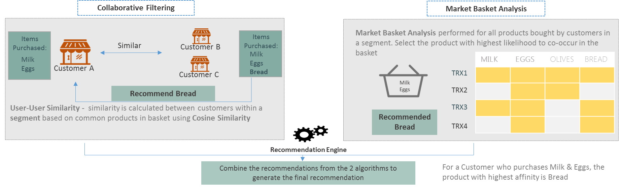
Case Study 1: Centralized ground truth enabled enterprise data lake
LV Solution
Illustrative Recommendation Engine
Back

Slide 62
Case Study 1: Centralized ground truth enabled enterprise data lake
Results and Benefits
Following were made available in a cost effective manner with automated scaling upon requirement
Workload centric data systems capable of handling multiple Advanced Analytics ML pipelines
Reporting out of Redshift spectrum
Adhoc analysis in Athena
Recommendation engine helped in targeting potential customers for cross – selling using the generated RFM scores.
Real time recommendations and insights provided to the marketing associates led to a 20% increase in the value of new orders from existing customers and also drove higher customer satisfaction.
Back

Slide 63
Case Study 2: Define & visualize metrics for real-time purchase trends
Overview
Client | The client is a major multi-national e-commerce market place giant
Problem | In a highly competitive e-commerce space it is important to keep the novelty of the marketplace / offerings to enhance customer experience, drive user and transaction growth
Solution | LatentView designed and implemented a set of metrics for trend analysis and built a real-time platform to visualize market trends, purchase trends, popular items etc. for any search/product term from 4TB of historic transaction data over 3 years with a response time lesser than 1000 ms
Impact | 20% of platform users (32% of searches) visited the marketplace website and contributed to a 3% uptick in transactions in select categories
Tools, Technologies & Techniques | Apache Hadoop, Apache Knox, Teradata, Kafka, Hive, Elastic Search, Bootstrap, NodeJS, Log Stash, AngularJS, jQuery
Operations & Roadmap | LatentView built this as a fully automated system requiring minimal maintenance. The focus of the ongoing engagement was to make incremental improvements, perform monthly maintenance activities, monitor the platform adoption, and ROI
Back

Slide 64
Case Study 2: Define & visualize metrics for real-time purchase trends
Context and Background
With increased competition in the e-commerce space, the client had to come up with interesting value adds for both their buyers and sellers, to reduce churn and improve upon user base / transaction growth. Client did not have a common platform which buyers/sellers could use to understand what the popular products were and how they were trending across geographies. However, development and deployment of such a tool is limited by several constraints.
Key Challenges:
Ingesting 1.2 TB, 4.5 billion records from legacy systems into responsive query system
The siloed nature of the data across business units required co-ordination and approvals from multiple business stakeholders
Security requirements for building an automated data pipeline across various systems is more complex
Need for ultrafast response time for queries in the order of 1000 ms
Being a multi-national company with presence across geographies, the platform must provide multilingual support
The system must be robust enough to work across multiple devices
Back

Slide 65
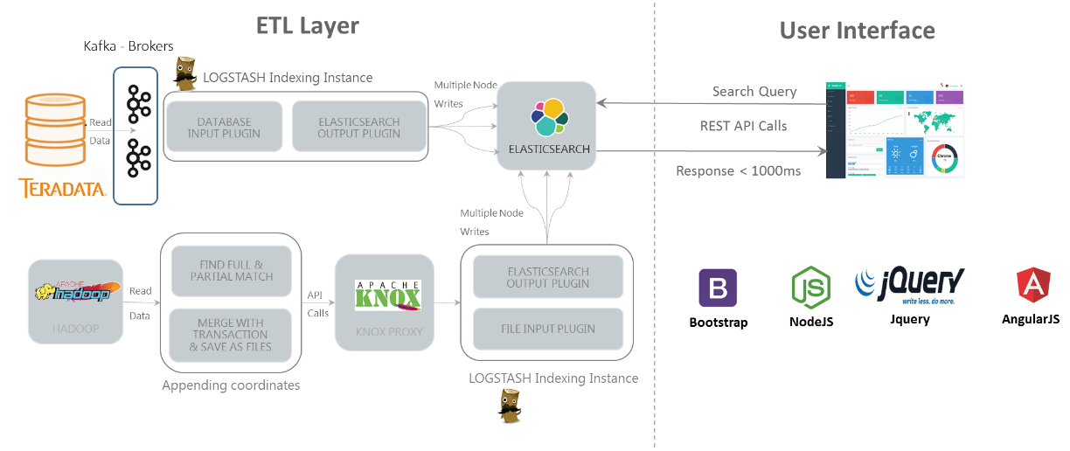
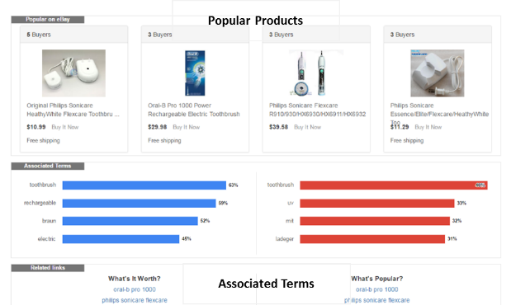
Case Study 2: Define & visualize metrics for real-time purchase trends
LV Solution
LatentView built and maintained a search engine using 3 years of transaction data and provided a real-time user query able platform to visualize market trends, purchase trends, popular items etc. for any search/product term and allows comparison between products and product categories.
Technical Architecture
Platform Snapshots
Back

Slide 66
Case Study 2: Define & visualize metrics for real-time purchase trends
Results and Benefits
The new platform led 20% of the platform users to visit the marketplace website and perform 32% product searches which resulted in an overall impact of 3% increase in transaction volumes across key product categories
To sum up the benefits by different user groups:
Sellers: Serves as an intelligence source to turn transaction data into decisions
Product price comparison with competitors enabling price optimization
Popular & trending products across brands to aid inventory management
Identifying high potential markets, red ocean markets, markets with high demand but unexplored by rivals etc. for strategic & operational decisioning
Buyers: Discover the hottest products, average price of products in any given time and place for informed and optimized purchases
Internal Users: Self-serving BI tool that can be used to compare trends across products, price comparison, demand, buyer-seller interactions etc.
Back

Slide 67
Case Study 3: Robust scalable data platform for analytics
Overview
Client | The client is a Europe based Automobile Manufacturer with several iconic brands in their portfolio
Problem | Costs incurred due to warranty claims had a negative impact of almost 2.5% on the bottom line of the company
Solution | Provided a robust scalable platform which modelled customer behaviour using driving patterns & warranty / repair data. This platform enables a user to carry out root cause analysis by correlating driving styles with warranty issues.
Impact | Warranty costs reduced by 35% for the “long pause and short trips” driving style due to proactive ‘drive right’ messaging communicated to at-risk drivers
Technologies & Techniques | AWS Databricks, Apache Spark, Mongodb, React, Html, JS, Scala, D3.JS, Spark MLIB K-means clustering, Random forest, Decision trees
Operations & Roadmap | LatentView continues to maintain the platform and the client visualization layer. New use cases for the data platform are being evaluated and a detailed roadmap for the future is being implemented.
Back

Slide 68
Case Study 3: Robust scalable data platform for analytics
Context and Background
Situation
Client was incurring millions of dollars as cost due to customer warranty claims. This cost directly impacted the company’s bottom line and indirectly impacted the customer perceived quality.
Challenges
The available data was huge in volume and had a number of dimensions (10 million cars across the globe with different controller versions, numerous engine & motor types, fuel etc.)
Data flowing in from the car’s controllers was not standard across vehicle and software releases.
Data format was unusable for any direct analysis. A single manual analysis would take on an average of 30 days and still in most of the cases would not result in an actionable insight.
Not clear if there is correlation between warranty cost and driving patterns.
Key Question
How can Client make use of the available data to reduce the cost to warranty claims?
Back

Slide 69
Case Study 3: Robust scalable data platform for analytics
LV Solution
LatentView developed a self-service and code-free analytics platform that can be used for a wide variety of use cases ranging from simple visualizations like data distribution to complex use cases like driver profiling and defect prediction.
Platform consists of an interactive user-interface, machine-learning pipelines and data pipelines.
Data pipelines to periodically convert the incremental sensor data from vehicle controllers into a useable aggregated format were developed.
Real time data summaries, model training & scoring built into the platform to enable the user to uncover driving patterns and run prediction models for different customer segments as and when required.
Technologies used: Machine learning (Scala), Parallel computing (Spark), Amazon Web Services (scalability) and D3
Back

Slide 70
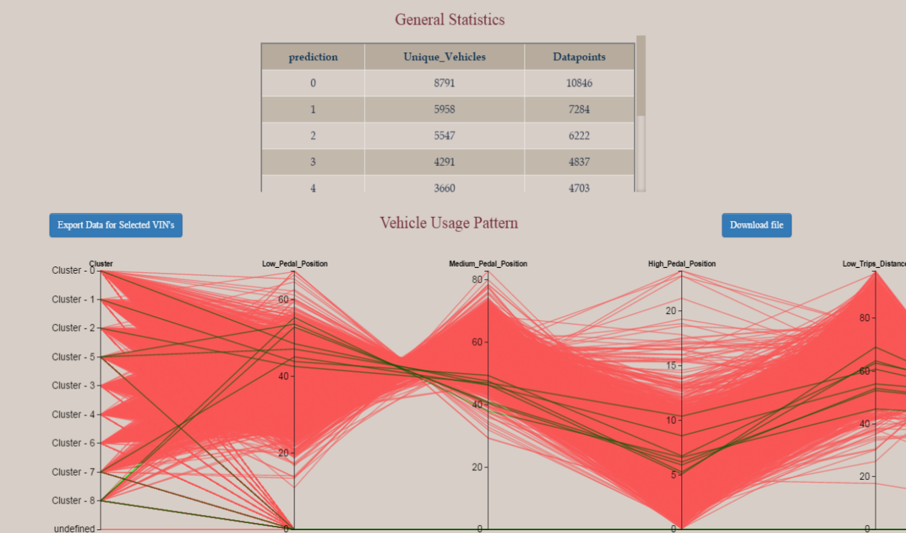
Case Study 3: Robust scalable data platform for analytics
Results and Benefits
SMART INSIGHTS TOOL
Self-service analytics tool was built in 90 days’ time. The tool runs on the cloud and could scale to even process petabytes of data. Now the user of the tool could play around with it and get answers to their questions faster.
FEATURES OF THE SMART INSIGHTS TOOL
Provides a better understanding of Vehicle usage profiles & correlation with Warranty claims.
Generates insight on Key areas of Product usage & Weakness
Speeds up Warranty claim analysis, (compared to highly time consuming manual analysis)
On the fly analysis is now possible
Uses cutting edge technology for scalability & efficiency
Back

Slide 71
Case Study 4: Integrated platform for tracking digital metrics
Overview
Client | Leading Global Beverage Company
Problem | To Provide providing wide spectrum of analysis using social media data like Brand monitoring, Event analysis, Product launch analysis, Weak signal analysis, Purchase Intent, Switchers analysis, Brand association analysis, Influencer analysis, Need space analysis etc.
Solution | Digital Metrics Tracker: Integrated platform that tracks all of the digital media metrics in a single place to analyze and market the content in the best possible media. Product/Innovation Identification: What consumers wants in a product and identify those specific needs that are not met by the current product catalogue and incorporate their needs/requirements in the existing products or as a whole new product. Opportunity/Need Space Analysis: What are the characteristics a particular demand space, are our products aligned in that direction and what are the consumers’ functional, emotional and technical drivers in selecting a product. Week/Strong Signal Analysis: What are the reasons behind sales dip or growth and identify those signals that can turn out to be a potentially problem/opportunity for the brand? Product/Campaign Pre-& Post Launch Analysis: What is the perception of our new product launched in the market or what is the impact of our new campaign and analyze how consumers adopted to their product?
Impact | LatentView has been the Digital & Social Media Analytics partner for the Client in implementing Social Media Analytics study, which helped client Marketing team, Global Insights team, Product Innovation Team etc. in positioning their products as well as in focused understanding of the consumer behavior. Automated real-time business intelligence application that provided the client an opportunity to view their brands’ social & digital marketing efforts in visually appealing & feature-rich Tableau dashboards.
Tools & Techniques | Data extraction and manipulation – Web scrapping through Python, SQL server, Teradata Data Extraction Paid tools like Radian6 Presentation - tableau, ppt and web applications Modelling – R & Python
Operations | LatentView team continues to maintain the platform, with weekly refreshes to the reports and monthly operational maintenance activities on the data pipeline
Back

Slide 72
Case Study 4: Integrated platform for tracking digital metrics
Context and Background
Analytics & Insights team as well as Marketing team of Client wanted to understand the performance of their marketing platforms and identify the best platform to market a specific campaign.
LatentView developed an integrated executive level Digital Media Metrics Tracking tool to track and analyse the campaigns across different marketing platforms and share insights with brand marketing teams
Back

Slide 73
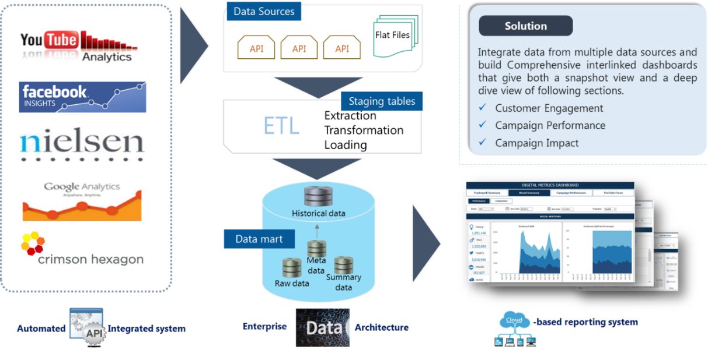
Case Study 4: Integrated platform for tracking digital metrics
LV Solution
LatentView collected and integrated the data from multiple data sources like Owned media (Website), Paid Media (3rd party website banners) and Earned/Social media (Facebook, Twitter, YouTube etc.).
LatentView developed an automated data extraction procedure by API scripts from various data vendors covering all the above-mentioned sources.
Designed an ETL layer which will integrate these data at different granularity and functionality.
Developed a visualization layer to feed the data into the Business Intelligence application.
Back

Slide 74
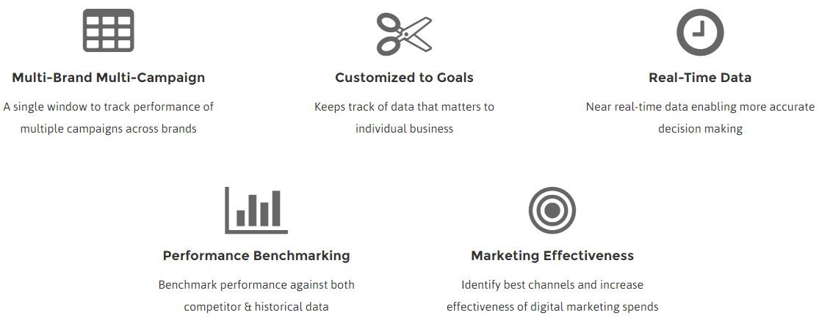
Case Study 4: Integrated platform for tracking digital metrics
Results and Benefits
Automated real-time business intelligence application provided the client an opportunity to view their brands’ social & digital marketing efforts in visually appealing & feature-rich Tableau dashboards.
Enabled CXOs to make quick data-driven insights from the company’s digital & social marketing efforts that cut across their Paid, Earned & Owned media spectrums.
Summary of Key Benefits
Back

Slide 75
Thank You!
Do You Have Any Questions?
www.LatentView.com
| Princeton | San Jose | Seattle | London |
Chennai | Singapore |
Email: Paresh.Chiney@latentview.com

